Slide 1
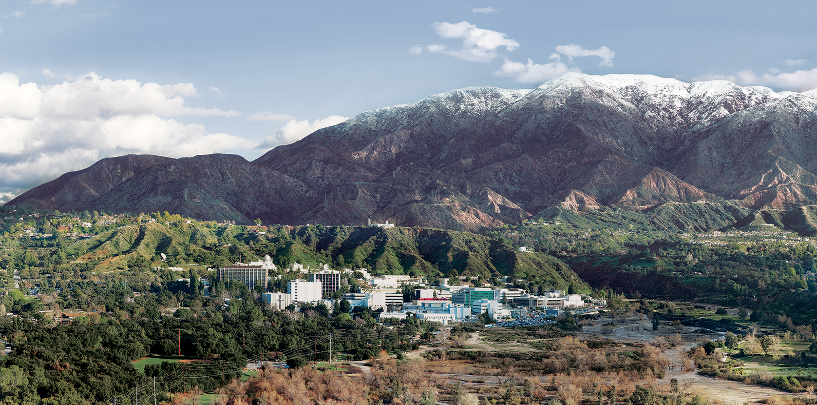
8. Radiances
Dr. David R. Thompson
Jet Propulsion Laboratory, Imaging Spectroscopy Group
July 20, 2019

Slide 2
Goals for this module
Describe factors affecting the physical measurement of radiance spectra
Interpret and apply calibration data to uncalibrated spectral data cubes
Validate radiances in remote field data using in-situ measurements

Slide 3
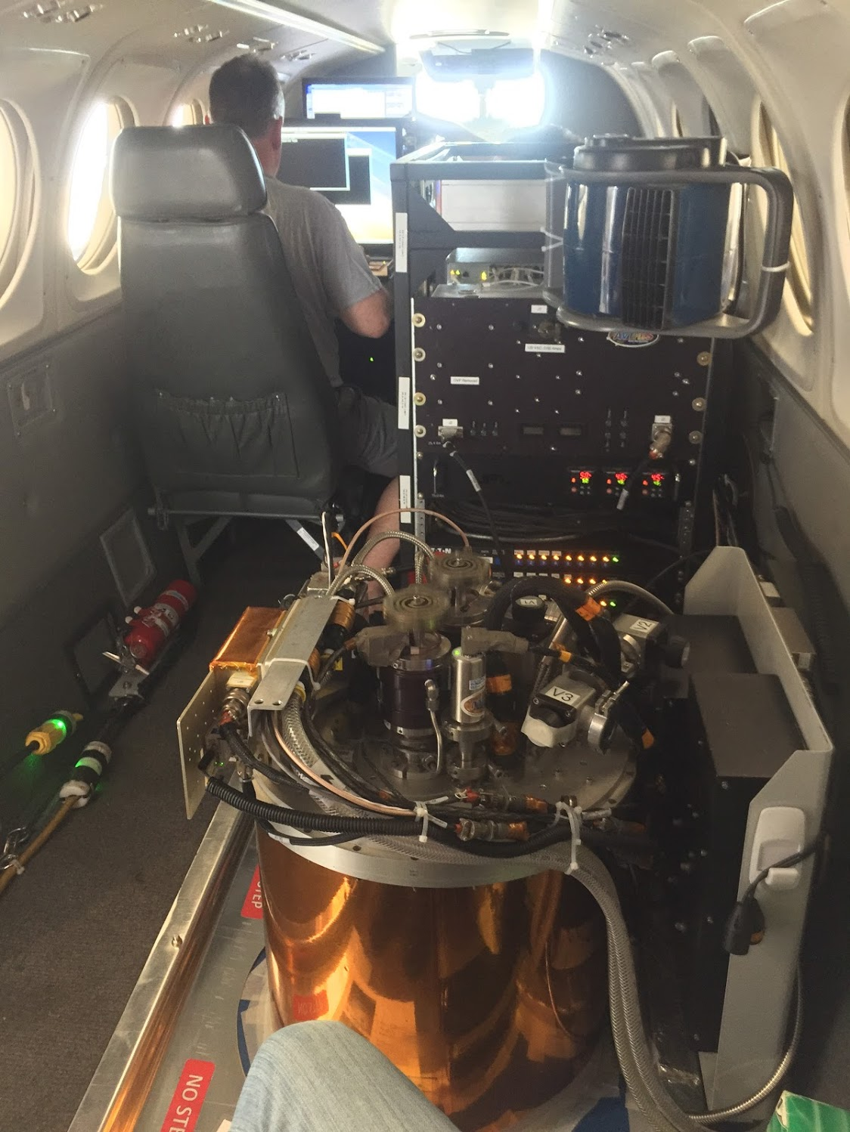
Reprise
AVIRIS-NG Installation

Slide 4
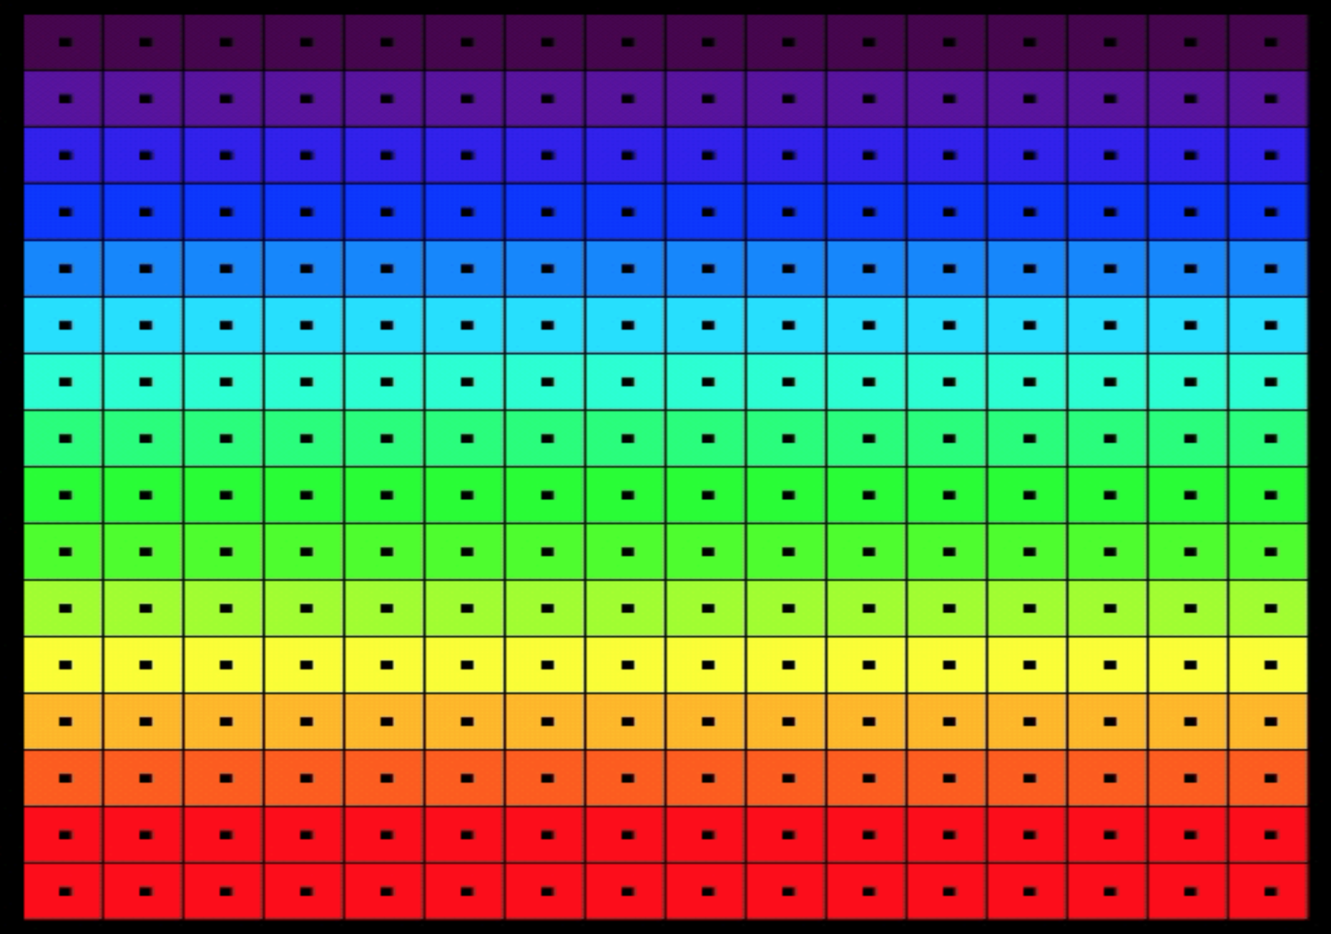
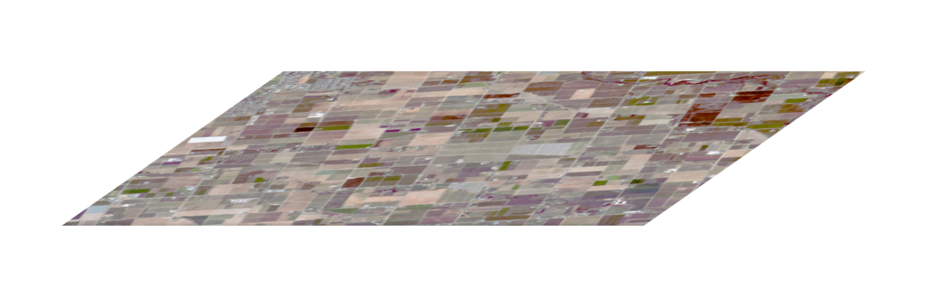
Conventions
Rows (spectral channels)
FPA
Spectrometer
Slit
Telescope
Samples (cross-track locations)

Slide 5
Working backwards from the FPA
Account for electronic effects - the unique, time-dependent radiometric response of each FPA element
Account for optical effects - the spatial and spectral “view” of each FPA element
Tie to the S.I. (absolute spectroradiometry)
FPA
Spectrometer
Slit
Telescope

Slide 6
Working backwards from the FPA
Correct dark offset
Account for electronic effects - the unique, time-dependent radiometric response of each FPA element
Account for optical effects - the spatial and spectral “view” of each FPA element
Tie to the S.I. (absolute spectroradiometry)
Correct pedestal shift
Correct panel ghost
Correct flat field
Correct bad pixels
Statistical destriping
Correct crosstrack scatter
Correct spatial scatter
Apply radiometric coefficients

Slide 7
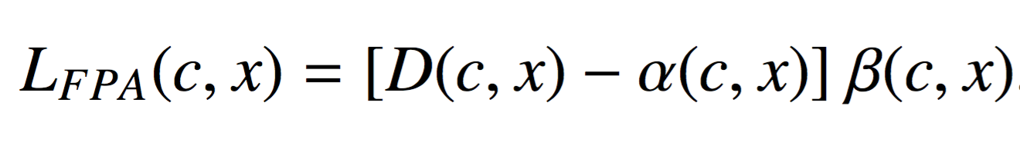
Basic radiometric model
For each crosstrack element x and spectral channel c
Radiance at FPA
uW nm⁻¹ sr⁻¹ cm⁻²
FPA Value
DN
Offset
DN
Gain
uW nm⁻¹ sr⁻¹ cm⁻² DN⁻¹

Slide 8
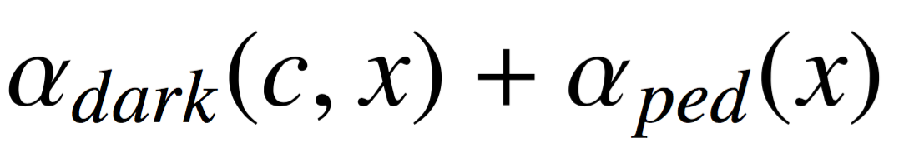
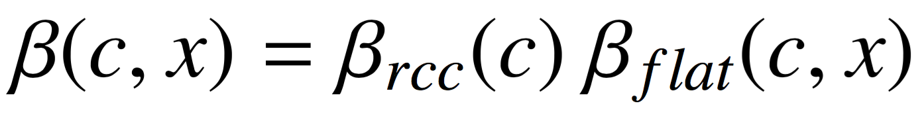
Basic radiometric model
For each crosstrack element x and spectral channel c
Offset
DN
Gain
uW nm⁻¹ sr⁻¹ cm⁻² DN⁻¹
Dark Level
(per element, each flightline)
Pedestal shift
(per spectrum, each frame)
Radiometric Coefficient
(per channel, each campaign)
Flat field
(per element, each campaign)

Slide 9
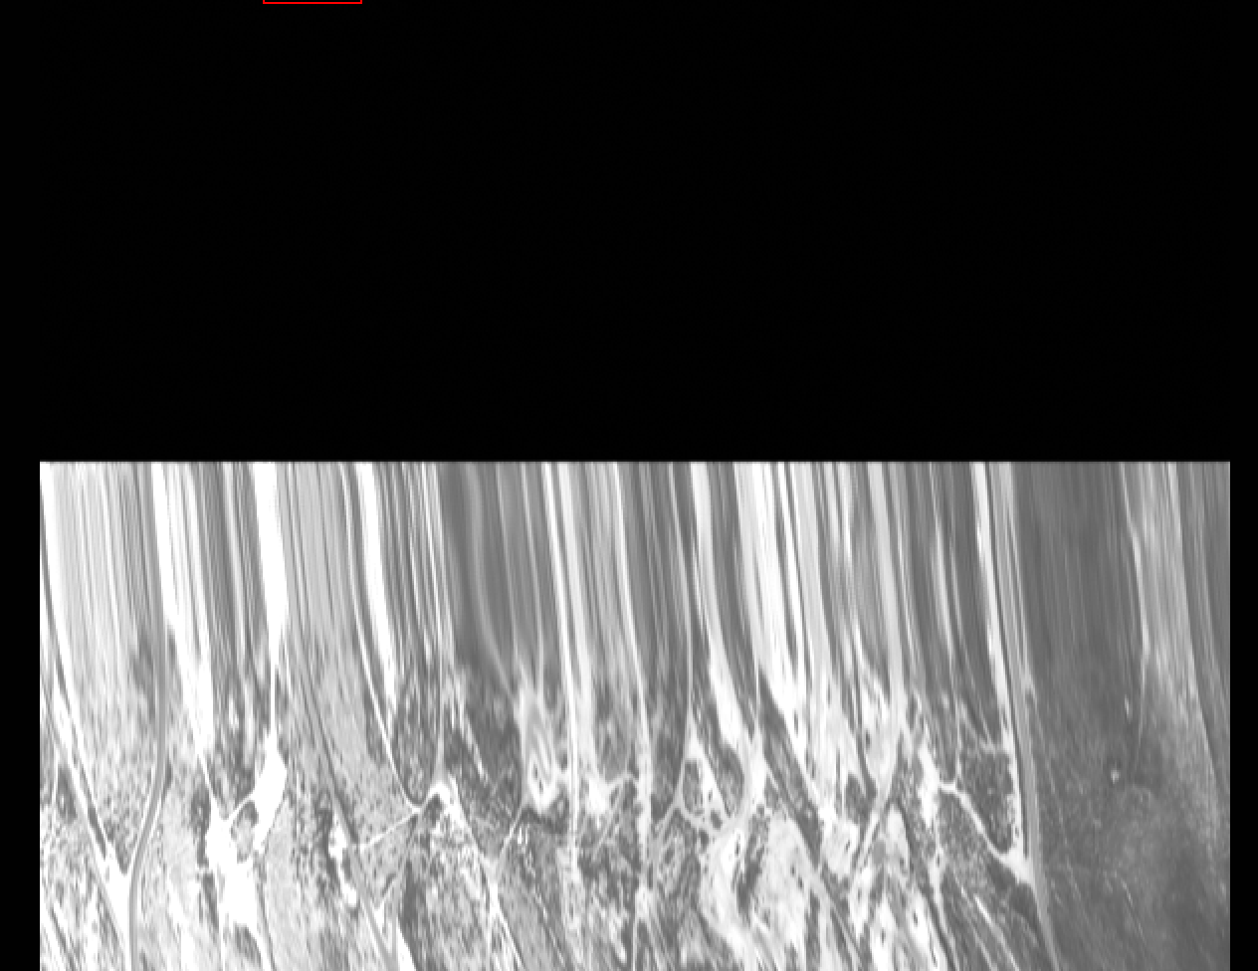
Components of offset
Estimate dark level from initial non-illuminated segment of flightline
Estimate pedestal shift from non-illuminated channels

Slide 10
Components of gain
Estimate RCCs using a NIST-calibrated source
Estimate flat field from a uniform sphere passed across the FOV

Slide 11
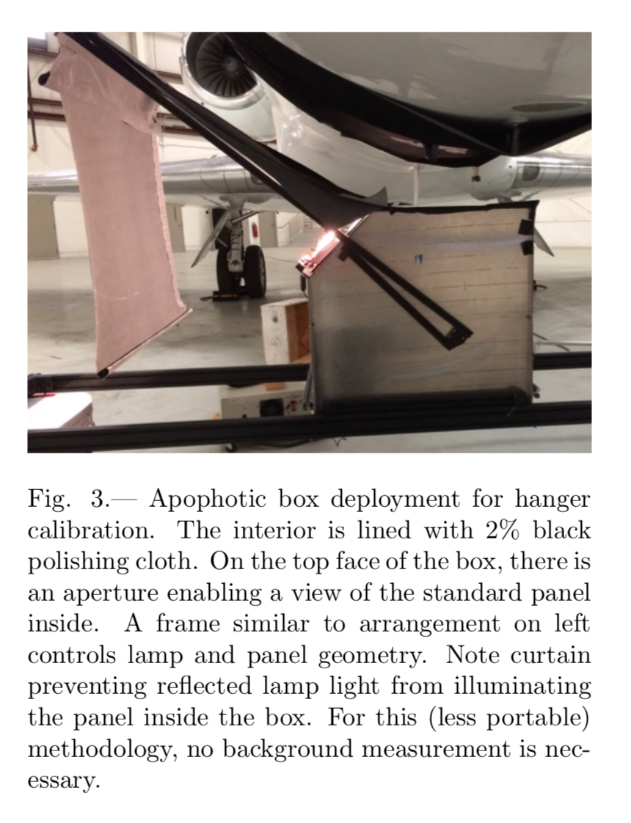
Estimate RCCs using a NIST-calibrated source
Chapman et al., Remote Sensing (submitted)

Slide 12
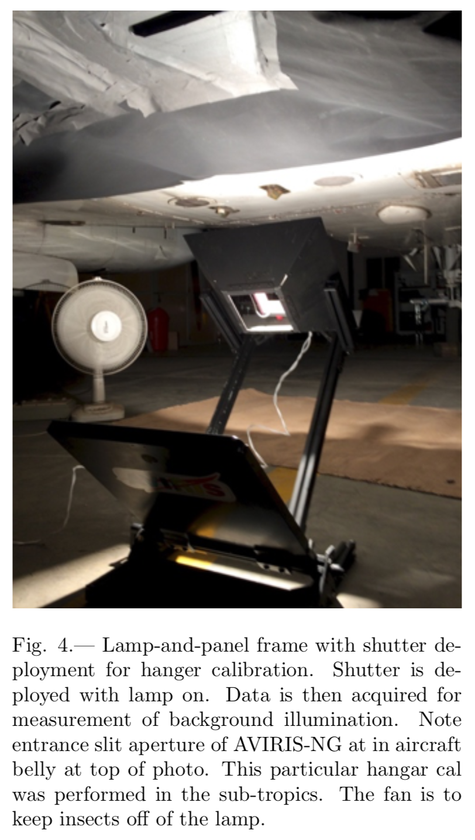
Estimate RCCs using a NIST-calibrated source
Chapman et al., Remote Sensing (submitted)

Slide 13
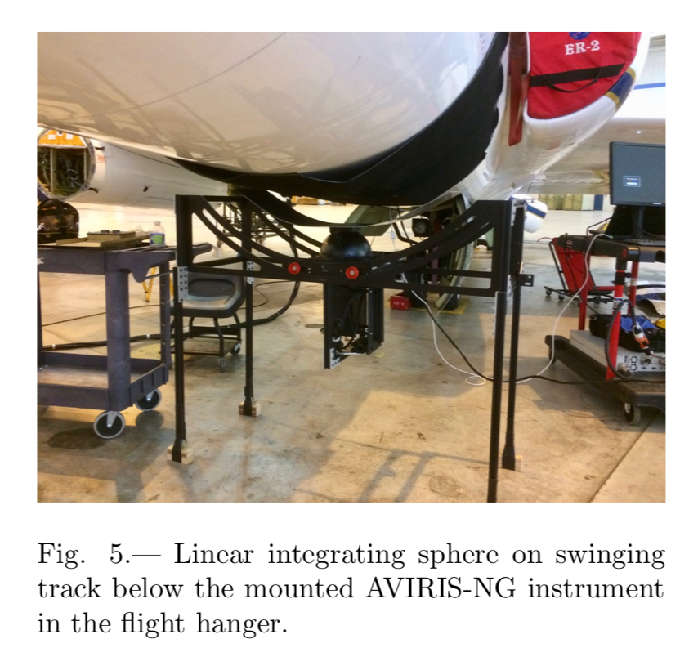
Estimate flat field from a uniformly-illuminated spherical cavity passed across the Field of View (FOV)
Chapman et al., Remote Sensing (submitted)

Slide 14
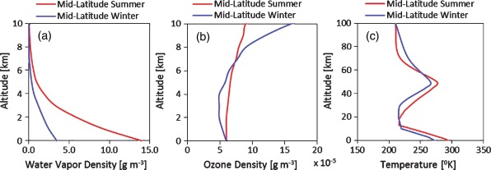
Validation method
images: Mishra et al., Heliyon 2015, wikimedia
scattering
RTM
absorption
reflection

Slide 15
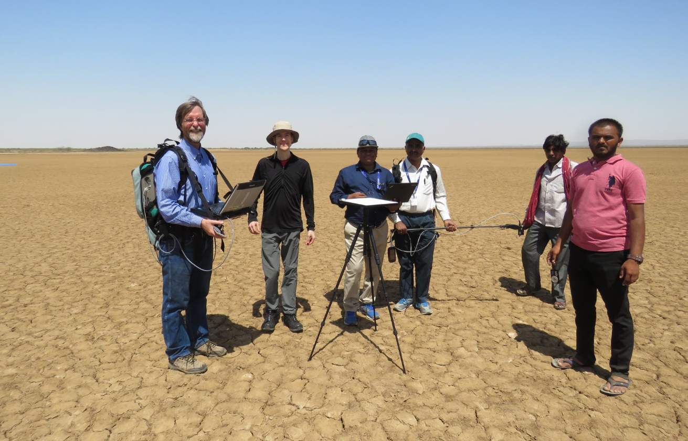
Validation
AVIRIS-NG remote measurement
Model from In-situ measurement
AVIRIS-NG
MODTRAN simulation
Residual

Slide 16
Other artifacts
Optical effects
Detector and alignment
Whole FPA
SRF correction
Electronic and thermal effects
NIST radiometry
FPA sub-region
Atmospheric wavelength tuning
Laboratory wavelength calibration
Panel Ghost
“Bad element” replacement
Markov destriping
Flat field
FPA element
Pedestal shift
Dark offset
milliseconds
minutes
months
years

Slide 17
A comprehensive correction strategy
Electronic effects - the time-dependent radiometric response of each detector
Optical effects - the spatial and spectral “view” of each detector
Calibration to the S.I. (absolute spectroradiometry)
Correct dark offset
Correct pedestal shift
Correct panel ghost
Correct flat field
Correct bad pixels
Statistical destriping
Correct crosstrack scatter
Correct spatial scatter
Apply radiometric coefficients

Slide 19
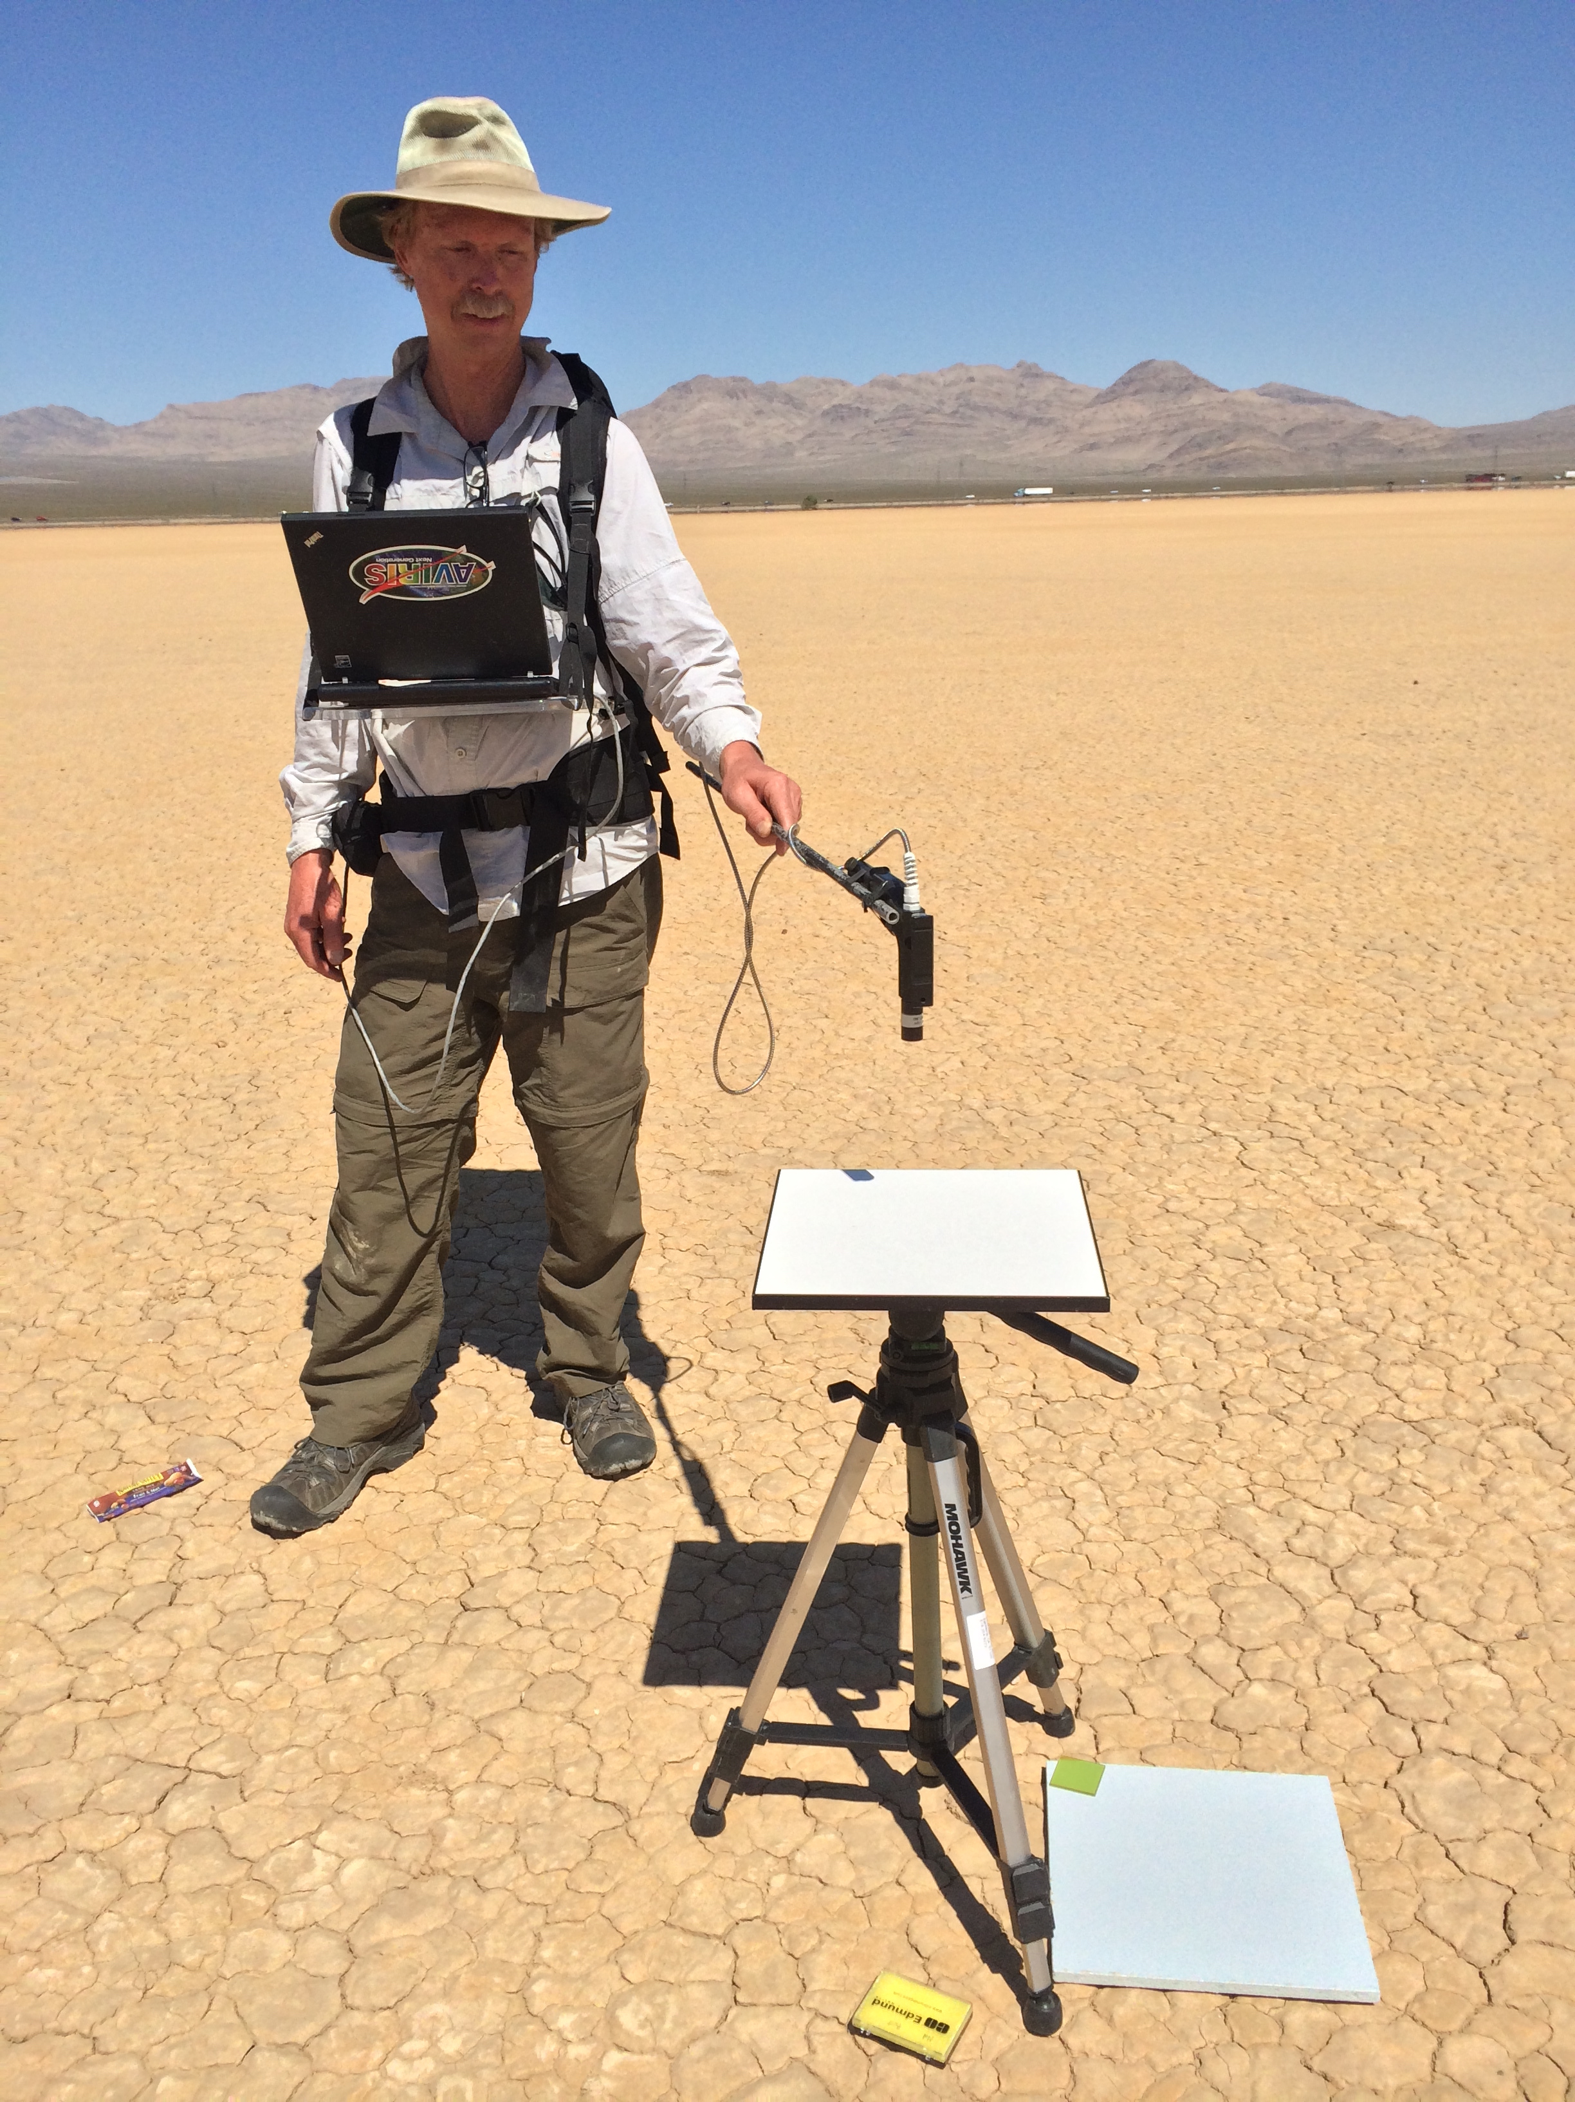
Exercise 7: Radiance Calibration / Validation
Objective: Calibrate digital numbers and “close the loop” with predicted radiances from surface measurements acquired coincidently with an overflight of Ivanpah Playa, NM.. Compare alternative Radiative Transfer Models (RTMs). Which is best? Files include:
predicted_radiance_atrem - a prediction of at-sensor radiance based on the approach of Thompson et al., (RSE 2015).
predicted_radiance_modtran - via the MODTRAN Radiative Transfer Model.
flat - a flat field frame
rcc.txt - a file of radiometric calibration coefficients
dark - a dark current frame
dn - an imaging spectrometer file containing raw spectrometer data
loc – a three band matrix containing latitude, longitude, and altitude for the (non-orthorectified) dn file.
Reflectance was measured between two blue tarps placed on the playa surface, and used in the radiative transfer model. The locations:
South tarp - 35.60285N, -115.40388W
North tarp - 35.60466, -115.40266

